Slide 1
WELCOME!
General Meeting
2/27/24
Please write your name on a raffle ticket as you come in!

Slide 2
Call to Order
Pledge of Allegiance

Slide 4
President (Geneviéve)
Congrats on making it halfway through the spring semester! Good luck on midterms <3
How was chili open?
Spring break plans??
Raffle drawing!

Slide 5
Vice President (Shannon)
Upcoming fundraiser: aluminum cans for Berea Animal Rescue Friends

Slide 6
Secretary (Elanna)
Reminders:
Check Jacket Connect for Rotary Club of Berea meetings/events!
Check your emails from me :)
Don't know how many service hours you have? Ask an officer and they can check for you!
Happy spring break (the bunny is here for spring motivation)!

Slide 7
Treasurer (Donovan)
Nothing to talk about
Enjoy Spring Break!!

Slide 8
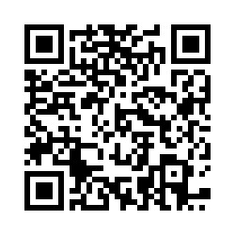
Club Service Chair (Nick)
Chili Open
Plastic collection increased after bench
Shameless plugs
Attendance

Slide 9
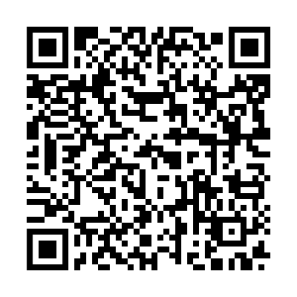
Community Service (Jen!)
Log your hours!
bit.ly/bwrotaracthours2324

Slide 10
Professional Development Chair (Kate)
Upcoming professional development session during general meeting on April 2nd

Slide 11
Public Relations Chair (Alyssa)
I will be posting about our next service event, St. Patty's day bingo with Generations Living, this week
Please repost and invite your friends!

Slide 12
Advisor (Marc)
Come to The Rotary Club of Berea meetings
Meetings will be in person and virtually.
Schedule of meetings is on Jacket Connect.
Rotary Club of Berea needs a secretary.
Upcoming TRC of Berea Meetings
March 5 – Business Meeting via Zoom, 6 PM
March 26 – 4-Way Test Speech Contest, 6-8 PM

Slide 13
Save the Date
Cuyahoga County Board of Elections Processing Night - Tuesday, March 19th
Signup and registration are on Jacket Connect
Generations Senior Living
Sunday, March 17th, 2-3 PM, St. Patty's Day Bingo!
Saturday, April 6th – event TBD
Active Minds Send Silence Packing
Tuesday, April 2nd
Shifts available via link on Jacket Connect

Slide 14
Closing
Recite the 4 Way Test
Questions?
Notes:
– Albert Einstein

