Slide 1
General Meeting
1/30/24

Slide 2
Welcome back!
Call to Order
Pledge of Allegiance

Slide 4
President (Geneviéve)
What song do you have on repeat right now?

Slide 5
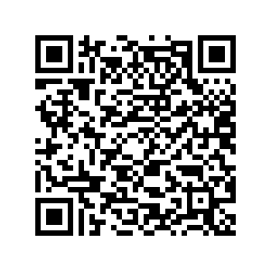
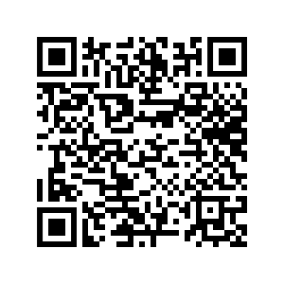
Apply to be an officer!
Check out each officer position at this link
ALL GENERAL MEMBERS: Fill out this interest form

Slide 6
Vice President (Shannon)
Great job at Involvement Fair!
Volunteer opportunity at Upcycle Parts Shop on Sunday, Feb 4 from 5-8pm

Slide 7
Secretary (Elanna)
Please check your Jacket Connect now and see if you can access the Rotary Club of Berea Rotascopes!
Jacket Connect app -> Groups -> Rotaract -> Documents -> Rotary Club of Berea Schedule
Jacket Connect website -> Groups -> Rotaract -> Files -> Rotary Club of Berea Schedule

Slide 8
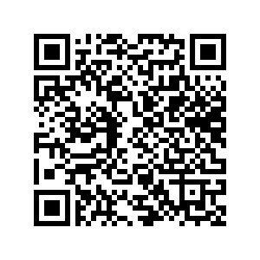
Treasurer (Donovan)
New Member Dues - $30
Bingo Fundraiser – Take the time to send money raised to @bwrotaract
Crush Can Sign-up
Save the Date – Ballot Counting, March 19th

Slide 9
Club Service Chair (Nick)
Continue to collect plastic!
5 lbs contribution = 1 service hour
Waiting on details for Chili Open Volunteering Opportunities
February 24th – Cuyahoga County Fairgrounds
Fundraising opportunity

Slide 10
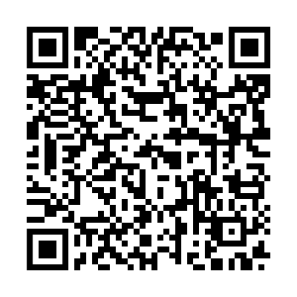
Community Service (Open)
Log your hours!
Involvement Fair (1/26)
Instagram Bingo (1 hour per bingo!)
Down Syndrome Association of Northeast Ohio (DSANEO) Sunburst Gala – Feb. 24th
bit.ly/bwrotaracthours2324

Slide 11
Professional Development Chair (Kate)
Attend Social Impact Career Fair (2/15 from 5-7 PM in the CIG) to explore job opportunities in:
Human/social services
Educational access, support, and enrichment
Public health & healthcare
Environmental sustainability
Speaker Opportunity: Ruth Cutcher from Quaker Voluntary Service
11-month experiment
Young adults work full-time in professional positions at community-based organizations while living in a cooperative house and worshiping with/being mentored by local Quakers
Fellows receive housing, transportation, food, support for health and wellness (including access to health insurance if needed), and a small stipend

Slide 12
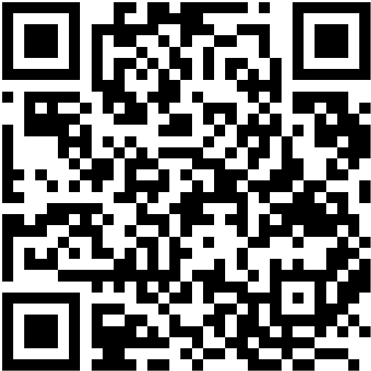
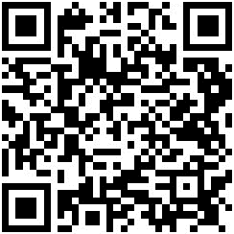
Professional Development Links!
Register for Career Fair
Feb 15, 5-7PM
Register for Career Fair Prep
Feb 8, 4-6PM

Slide 13
Public Relations Chair (Alyssa)
Let's Taco Bout Service event next general meeting!
Share our Instagram post later this week
Bring a friend!

Slide 14
Advisor (Marc)
Come to The Rotary Club of Berea meetings
Meetings will be in person and virtually.
Schedule of meetings is on Jacket Connect.
Rotary Club of Berea needs a secretary.
Upcoming TRC of Berea Meetings
FEB. 6: BUSINESS MEETING (Via Zoom)

Slide 15
Closing
Recite the 4 Way Test
Questions?
Notes:
– Albert Einstein

